Slide 1

More about Python

Slide 2
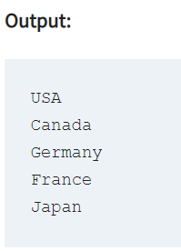
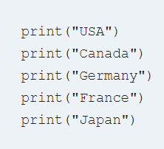
Recap of what we covered last year
https://www.w3resource.com/python-exercises/python-basic-exercises.php
Python basics -> exercises, practice and solutions
The print() function

Slide 3
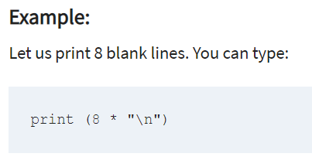
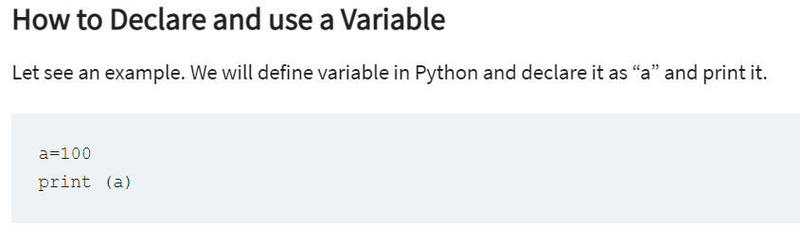

Slide 4
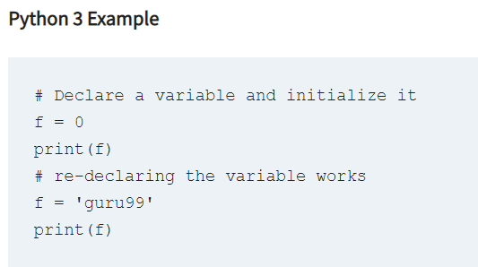
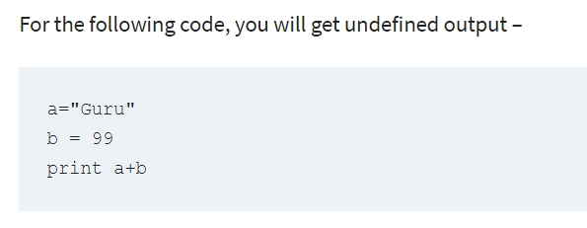

Slide 5
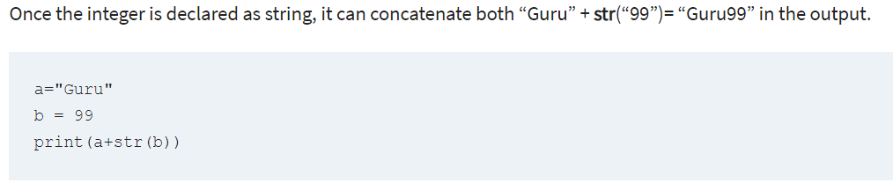

Slide 6
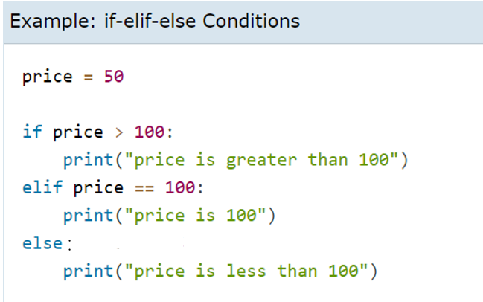
Basic if statement

Slide 7
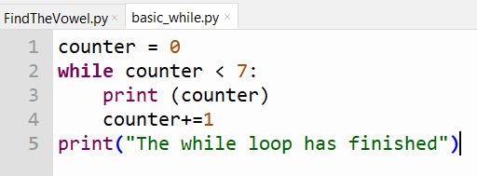
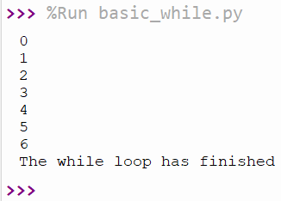
Basic while loop
The Output:

Slide 8
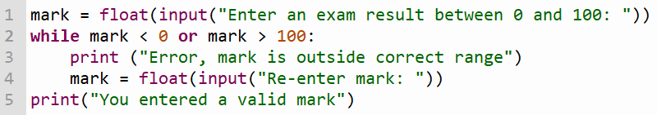
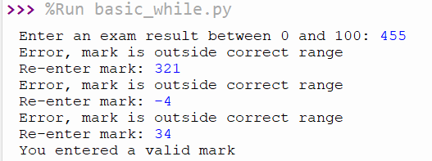
While loop
The Output:

Slide 9
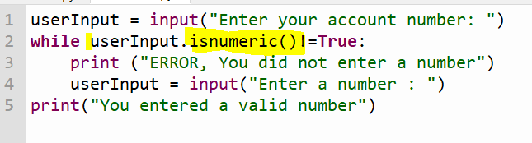
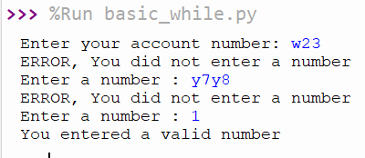
While loop
The Output:

Slide 10
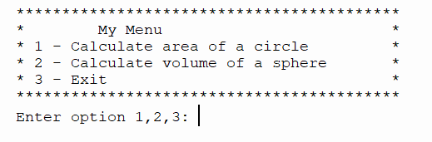
PRACTICE TIME
Using a while loop and if, elif, else statements create code that has an output that looks like this

Slide 11
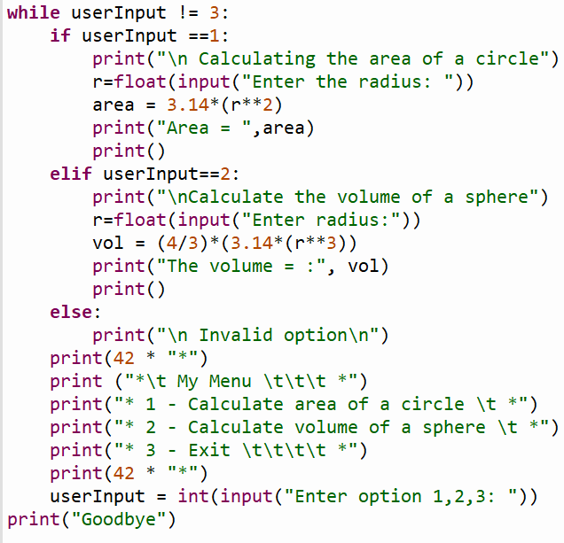
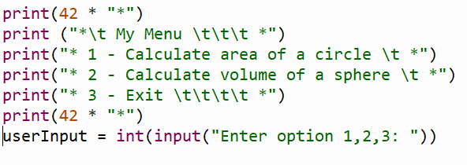
THE CODE

Slide 12
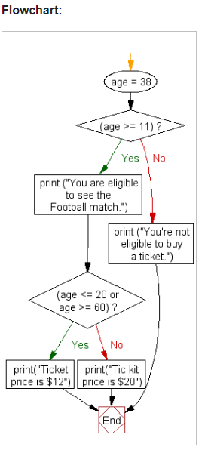
Nested Conditional Statements
In this example age is set to 38, therefore the first expression (age >= 11) evaluates to True and the associated print statement prints the string "You are eligible to see the Football match". There after program control goes to next if statement and the condition ( 38 is outside <=20 or >=60) is matched and prints "Tic kit price is $12".

Slide 13
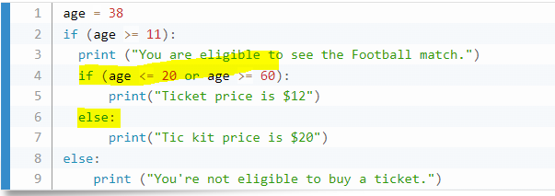
Nested Conditional Statements Example 1

Slide 14
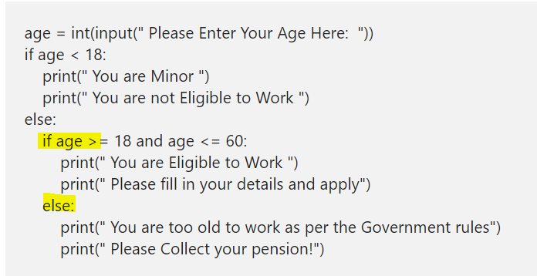
Nested Conditional Statements Example 2

Slide 15
Practice Time – Code this algorithm
Driver Licence Eligibility
Age >= 17
True
False
Has provisional licence
Output: Not eligible to apply> you must be 17 years or older
False
True
Output: Not eligible to apply. Get a provisional licence
Output: Eligible to apply

Slide 16
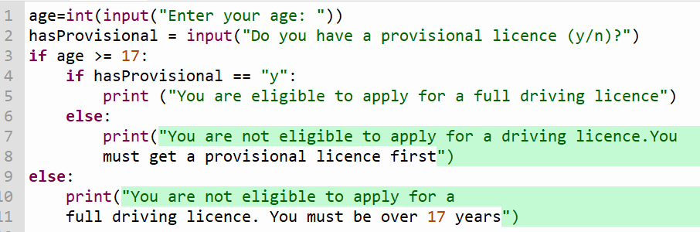
Practice Time – Code this algorithm
Driver Licence Eligibility

Slide 17
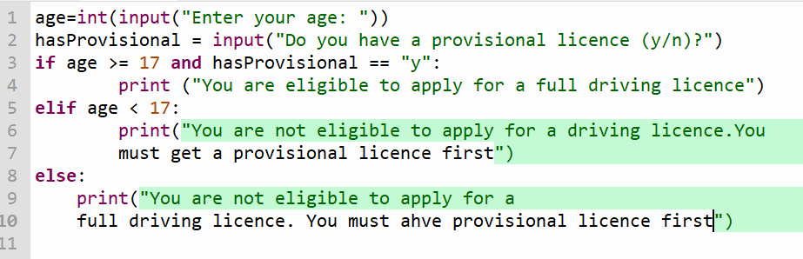
Driver Licence Eligibility using Boolean operators

Slide 18
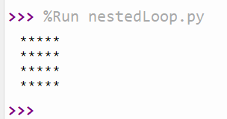
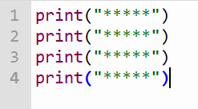
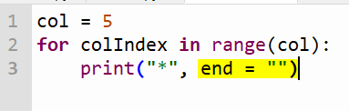

Iteration: Nested Loops
We can use nested loops to reduce the amount of code needed for the above.
Columns
* | * | * | * | *
* | * | * | * | *
* | * | * | * | *
* | * | * | * | *
Rows
The end =“” is needed to avoid moving to a new line after each star is printed.

Slide 19
Iteration: Nested Loops
https://www.youtube.com/watch?v=qk3q8n4EUE4
Nested Loop Tutorial

Slide 20
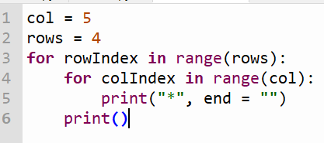
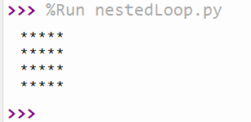
Iteration: Nested Loops
We can use nested loops to reduce the amount of code needed for the above.
Columns
* | * | * | * | *
* | * | * | * | *
* | * | * | * | *
* | * | * | * | *
Rows

Slide 21
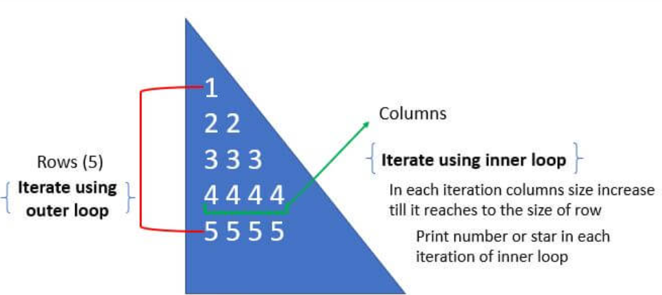
Iteration: Nested Loops Print Shapes

Slide 22
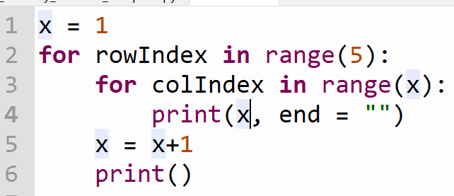
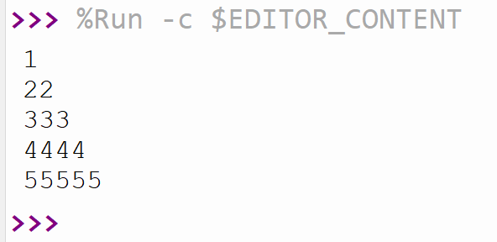
Iteration: Nested Loops Print Shapes

Slide 23
Iteration: Nested Loops Print Shapes
https://pynative.com/print-pattern-python-examples/#h-pyramid-pattern-of-stars-in-python
Webpage for coding different shapes in python

Slide 24
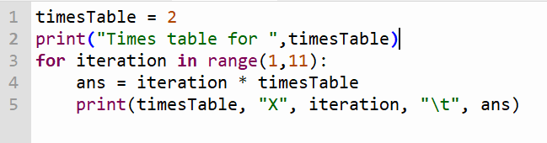
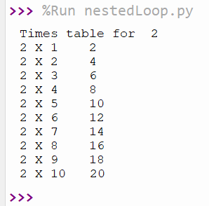
Nested Loops – Times Tables Example

Slide 25
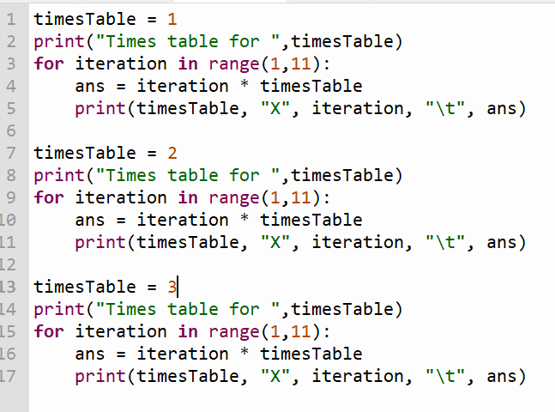
Nested Loops – Times Tables from 1 to 3
This method is fine if we only want to print a small number of tables but it is not efficient if we want to print 1 to 12 times.

Slide 26
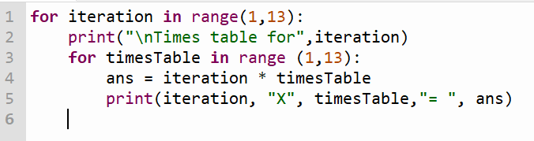
Nested Loops – Times Tables from 1 to 12
Using a nested loop to print all the tables from 1 to 12, uses only a few lines of code and so is much more efficient.

